Slide 1


GPS Geofence System
Expert Systems
Sebastián Mejía Serna
2019

Slide 2
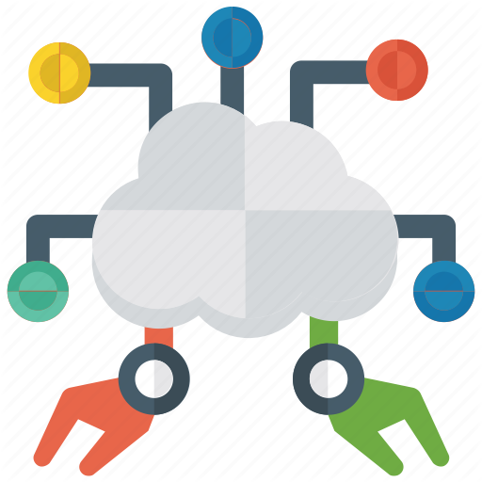
Expert systems
An expert system is a computer program that uses artificial intelligence (AI) technologies to simulate the judgment and behavior of a human or an organization that has expert knowledge and experience in a particular field.

Slide 3

GPS
The Global Positioning System (GPS) is a satellite-based navigation system made up of at least 24 satellites. GPS works in any weather conditions, anywhere in the world, 24 hours a day, with no subscription fees or setup charges. The U.S. Department of Defense (USDOD) originally put the satellites into orbit for military use, but they were made available for civilian use in the 1980s.

Slide 4
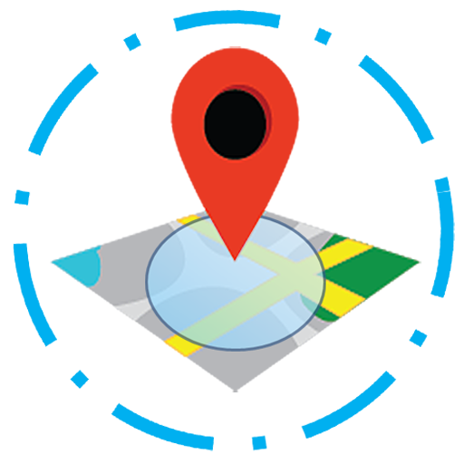
Geofencing
Geofencing is a location-based service in which an app or other software uses GPS, RFID, Wi-Fi or cellular data to trigger a pre-programmed action when a mobile device or RFID tag enters or exits a virtual boundary set up around a geographical location, known as a geofence.

Slide 5
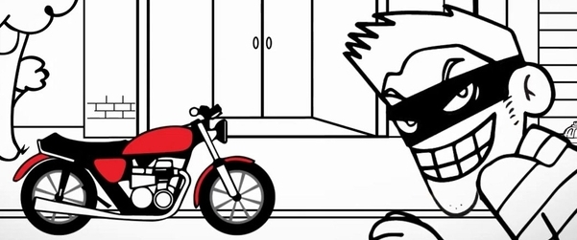
Problematic
While Medellín tries to fade the trace of violence with the lowest homicide rate of the last thirty years, motorcycle theft is growing, with an increase of 13% over the previous year.
Every day 16 motorcycles are stolen in the Valle Aburrá, most while the unsuspecting owner makes a turn and leaves his motorcycle parked on the street.

Slide 6
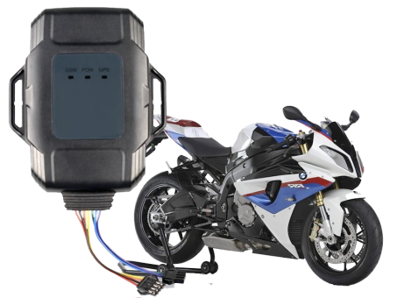
Solution
GPS system to increase the chances of recovering vehicles in case of loss or theft.
This GPS must have remote shutdown, nationwide tracking, location requests, disconnection alert, and creation of geofences. Being a support network for the national police.

Slide 7
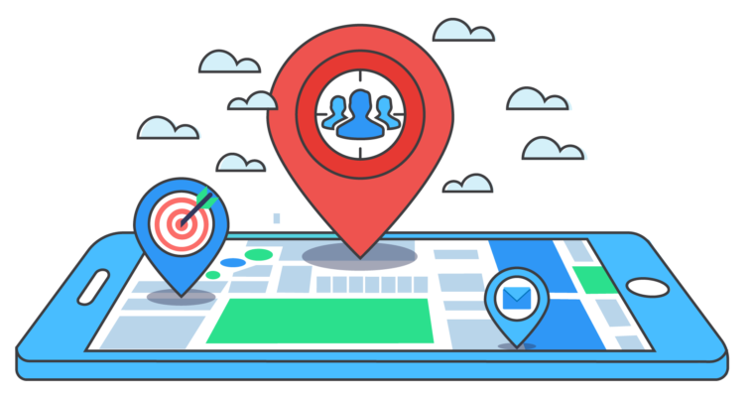
Solution
The added value of this GPS will be the possibility of creating geofences. That is why the expert system that is proposed will allow the implementation of this tool more easily and prevent theft of vehicles that are parked on public roads.

Slide 9
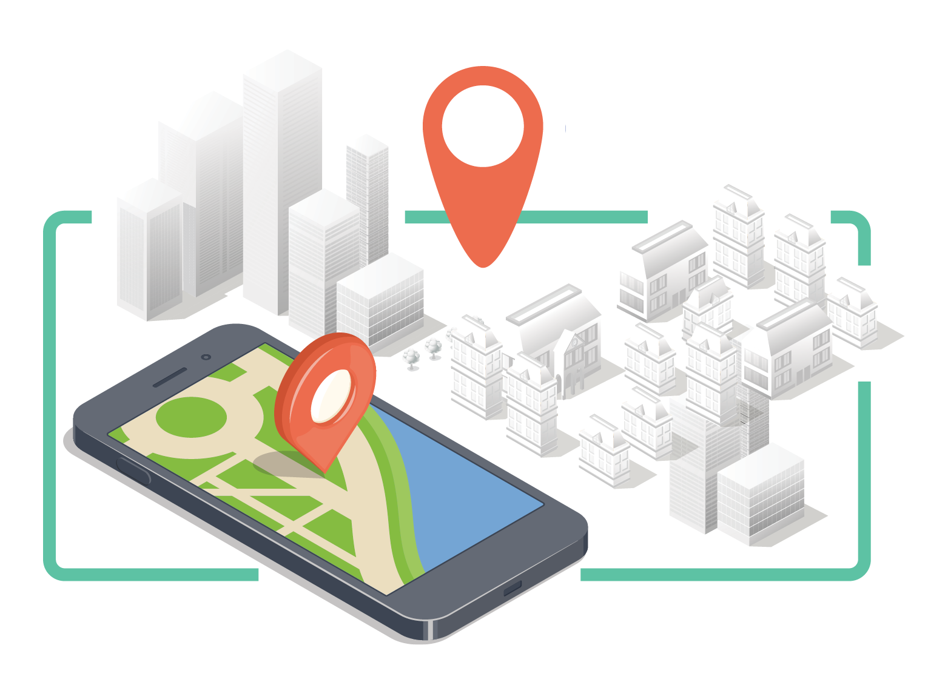
Petri Rules
If p₁ & t₁ then (p₂ & p₄) = 1 & p₁ = 0
If p₂ & t₂ then p₃ = 1 & p₂ = 0
If p₃ & t₃ then (p₄ & p₉) = 1 & p₃ = 0
If p₄ & p₃ & t₄ then (p₅ & p₉) = 1 & (p₄ & p₃) = 0
If p₄ & t₄ then p₅ = 1 & p₄ = 0
If p₅ & t₅ then p₆ = 1 & p₅ = 0
If p₆ & t₆ then p₇ = 1 & p₆ = 0
If p₇ & t₇ then p₈ = 1 & p₇ = 0
If p₈ & t₈ then p₉ = 1 & p₈ = 0
If p₉ & t₉ then p₁₀ = 1 & p₉ = 0
If p₉ & p₃ & t₉ then p₁₀ = 1 & (p₉ & p₃) = 0
If p₉ & p₅ & p₆ & p₇ & p₈ & t₉ then p₁₀ = 1 & (p₉ & p₅ & p₆ & p₇ & p₈) = 0
If p₁₀ & t₁₀ then p₁ = 1 & p₁₀ = 0

Slide 10
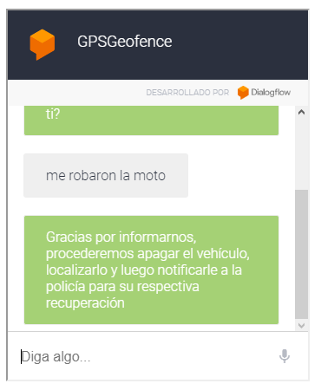


Slide 11
Conclusion
We now know the all about project and this expert system will be useful for a lot of people who want to choose his/her security.
To conclude this report, expert system is undeniably reliable in terms of providing reasonable and highly valuable decisions. Knowledge and experiences from a human expert can lead to the critical decision-making in achieving success. Yet, as humans have limitations in terms of how much of knowledge is comprehendible by a person and the possible fatigue of dealing with too much work, the expert system doesn’t have any.

Slide 12
Conclusion
The rapid change and improvement of technologies will gradually decrease the cost for implementing an expert system. This will significantly reduce the financial burden for small companies in deciding the implementation of expert system. In the business world, organizations often faced trouble in making tough decisions and overcome complex problems. Customers often require computerized systems to support their decision-making. All these criteria can be met with the implementation of the expert system.

Slide 13

Thank you very much!
Sorry! I don’t speak English

